Slide 1
Different Computing Devices

Slide 2


Mobile devices
Differ from workstations
Smaller
Unique interface
Different OS
Smartphones
Tablets
Laptops

Slide 3


Workstations/Servers
Workstations
"Beefed up" desktop
Specialized hardware/software
Faster and more capable
Servers
Used to assist other computers
May have multiple processors/storage drives
Types:
Email
Authentication
Web

Slide 4
Gaming consoles
Specialized computers designed for gaming
Additional apps for added features
Unique user interface
Eighth generation of gaming consoles include the PS4, XBox One, and Wii U

Slide 5
IoT Devices

Slide 6

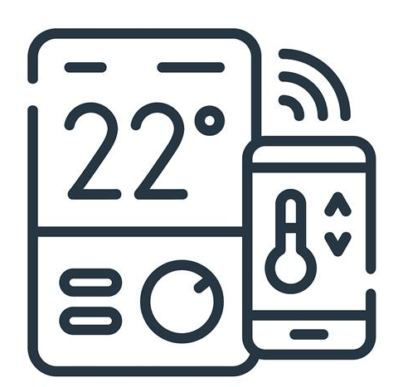
IoT Devices
IoT Devices
Physical devices connected to the internet
Home Appliances
Smart fridges
Smart coffeemaker
Home Automation Devices
Thermostats
Security Systems
IP Cameras

Slide 7
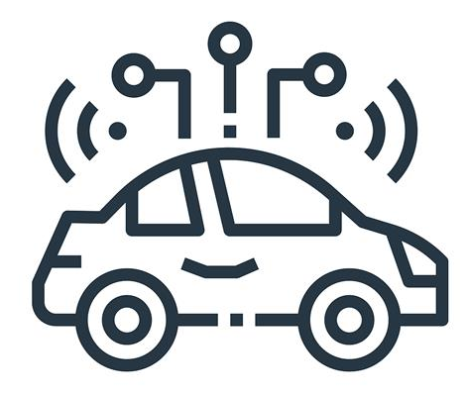
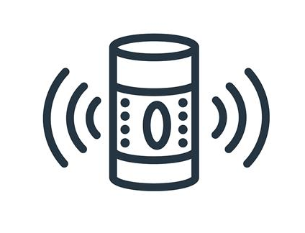
IoT Devices
Modern Cars
Intelligent Cars
Streaming Media Devices
Amazon Fire Stick
Google Echo
Medical Devices
Asthma Monitoring System
AI-Powered Insulin Pumps

